Slide 1
VENKATESAN.K
Final Project

Slide 2
PROJECT TITLE
EVALUATING STUDENT PERFORMANCE AND DROPOUT PREDICTION WITH RANDOM FOREST

Slide 3


AGENDA
The agenda for evaluating student performance and dropout prediction using Random Forest involves several key steps. Firstly, data collection is essential, encompassing academic records, demographic information, attendance, and socio-economic factors. Next, data preprocessing is crucial for cleaning, transforming, and encoding features to ensure compatibility with the Random Forest algorithm. Feature selection is then conducted to identify the most relevant predictors of student performance and dropout. Subsequently, the Random Forest model is trained on historical data, utilizing a subset of decision trees to predict student outcomes. Evaluation metrics such as accuracy, precision, recall, and F1-score are employed to assess the model's performance. Furthermore, techniques like cross-validation are applied to validate the model's generalizability and robustness. Interpretability of the model's output is also considered to understand the factors contributing to student success or dropout. Lastly, the model is deployed to predict future student outcomes, enabling timely interventions and support strategies to prevent dropout and improve overall academic performance. Regular monitoring and refinement of the model ensure its efficacy in addressing the evolving needs of the educational system.
3/21/2024 Annual Review

Slide 4

PROBLEM STATEMENT
The problem statement involves evaluating student performance and predicting dropout rates using Random Forest (RF) models. With the increasing emphasis on personalized education and early intervention strategies, it's crucial to develop efficient systems capable of identifying students at risk of academic underachievement or dropout. By harnessing the power of RF, which is an ensemble learning technique based on decision trees, we aim to construct robust predictive models that can leverage diverse features such as demographic data, academic history, socio-economic status, and behavioral patterns. These models will analyze large-scale datasets collected from educational institutions to identify patterns indicative of student performance and dropout risk. The primary objective is twofold: first, to accurately evaluate student performance based on various indicators, allowing educators to tailor interventions and support strategies accordingly; second, to predict dropout likelihoods with high precision, enabling proactive measures to prevent attrition and enhance student retention rates. Through the utilization of RF algorithms, which are renowned for their ability to handle complex datasets and nonlinear relationships, this study seeks to provide educational stakeholders with actionable insights to improve student outcomes and foster a more inclusive learning environment.

Slide 5

PROJECT OVERVIEW
The project aims to evaluate student performance and predict dropout rates using Random Forest, a versatile machine learning algorithm. By leveraging student demographic data, academic records, and socio-economic factors, the Random Forest model will be trained to classify students into categories such as high, medium, or low performers and predict the likelihood of dropout. The project begins with data collection from educational institutions, including student information such as age, gender, socioeconomic status, previous academic performance, attendance records, and extracurricular activities. Preprocessing techniques will be applied to handle missing values, normalize data, and encode categorical variables. Feature engineering will extract relevant features to enhance the predictive power of the model. The Random Forest algorithm will then be trained on labeled data to learn complex patterns and relationships between input variables and student outcomes. Model evaluation will involve cross-validation and performance metrics such as accuracy, precision, recall, and F1-score. The project's value proposition lies in its potential to provide early intervention strategies for at-risk students, optimize educational resources, and improve overall student retention rates. Additionally, insights gained from the analysis can inform policy decisions and interventions aimed at improving educational outcomes.

Slide 6

WHO ARE THE END USERS?
The end users for evaluating student performance and dropout prediction with Random Forest extend across multiple domains within the educational sector. Educational institutions, including schools, colleges, and universities, stand as primary beneficiaries. Administrators and educators can utilize Random Forest models to assess student performance comprehensively, identifying areas of strength and weakness across diverse subjects and educational levels. By analyzing various factors such as academic scores, attendance records, socio-economic background, and behavioral patterns, educators gain insights into individual student trajectories, enabling personalized interventions to support struggling students and promote academic success. Additionally, policymakers and educational researchers can leverage Random Forest algorithms to conduct large-scale analyses of educational data, informing strategic decisions related to curriculum development, resource allocation, and intervention strategies. Beyond educational institutions, government agencies concerned with education policy and funding allocation may also find value in utilizing Random Forest models for dropout prediction and performance evaluation to implement targeted interventions aimed at reducing dropout rates and improving overall educational outcomes on a societal level.

Slide 7

YOUR SOLUTION AND ITS VALUE PROPOSITION
The utilization of Random Forest algorithms presents a robust solution for evaluating student performance and predicting dropout rates in educational settings. By leveraging ensemble learning techniques, Random Forests harness the collective wisdom of multiple decision trees to provide accurate predictions. Through feature importance analysis, the algorithm identifies the key factors influencing student performance and dropout likelihood, such as attendance records, grades, socio-economic background, and behavioral indicators. This holistic approach allows educators and administrators to gain actionable insights into students' academic progress and potential risks of disengagement. The value proposition lies in its ability to handle large datasets efficiently, accommodate diverse types of input variables, and deliver interpretable results. Moreover, Random Forest models offer resilience to overfitting and noise, enhancing their reliability in real-world educational contexts. By leveraging predictive analytics powered by Random Forests, educational institutions can proactively identify at-risk students, intervene with targeted support strategies, and ultimately improve retention rates. This not only benefits individual students by providing timely assistance but also contributes to the overall success and effectiveness of educational programs.

Slide 8

THE WOW IN YOUR SOLUTION
The wow factor in utilizing Random Forest for evaluating student performance and dropout prediction lies in its robustness and versatility. Random Forest, a powerful ensemble learning technique, excels in handling high-dimensional data with complex interactions, making it ideal for analyzing multifaceted student performance metrics. Its ability to handle both numerical and categorical data, along with its resistance to overfitting, ensures reliable predictions even with noisy or incomplete datasets. Moreover, Random Forest provides insight into feature importance, highlighting which factors significantly influence student outcomes, aiding educators in targeted intervention strategies. Its ensemble nature, combining multiple decision trees, enhances generalization and model stability, crucial for real-world deployment in dynamic educational settings. Furthermore, the interpretability of Random Forest facilitates understanding and trust in the predictive outcomes, fostering collaboration between data scientists and education practitioners. The wow factor extends to its scalability, allowing seamless integration with existing educational systems for continuous monitoring and personalized support. By harnessing the predictive power of Random Forest, institutions can proactively identify at-risk students, implement timely interventions, and ultimately enhance student success rates, revolutionizing educational outcomes with data-driven insights.
3/21/2024 Annual Review
8

Slide 9
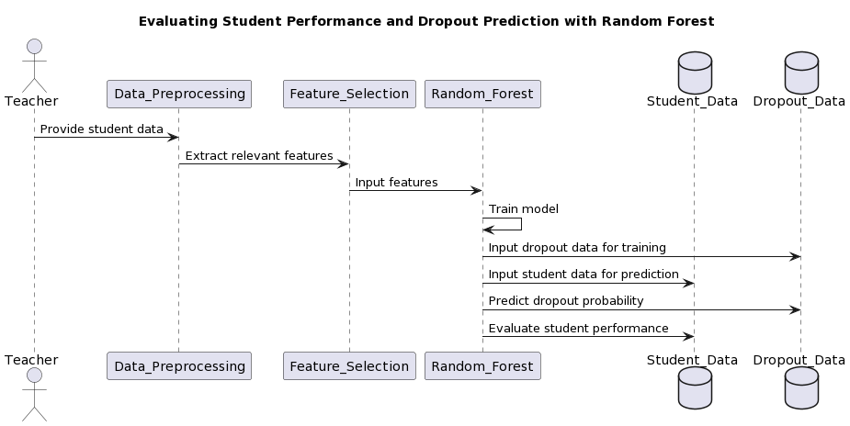
MODELLING
9

Slide 10
RESULTS
Random Forest offers a robust solution for evaluating student performance and predicting dropout rates. By leveraging an ensemble of decision trees, Random Forest can effectively handle high-dimensional data and capture complex relationships between student attributes and outcomes. In the context of evaluating student performance, Random Forest can analyze a variety of factors such as academic records, attendance, socio-economic background, and extracurricular activities to provide insights into student progress and potential areas of improvement. Its ability to handle both numerical and categorical data makes it versatile for this task. Moreover, Random Forest's interpretability allows stakeholders to understand which features contribute most significantly to student performance, aiding in targeted interventions and support systems. In terms of dropout prediction, Random Forest excels at identifying early indicators such as declining grades, absenteeism, or behavioral changes that may signal a student's likelihood to drop out. By analyzing historical data on student retention and dropout rates, Random Forest can generate predictive models to identify at-risk students and facilitate timely interventions to improve retention rates and ensure student success. Overall, Random Forest presents a comprehensive solution for assessing student performance and predicting dropout rates, offering valuable insights to educators and administrators for proactive intervention strategies.
10

